Slide 1
Analyzing and Predicting SpaceX Launch Outcomes with Data Science
Dheekshva Rajkumar
06.08.2025

Slide 2
Outline
Executive Summary
Introduction
Methodology
Results
Conclusion
Appendix

Slide 3
Executive Summary
Methodologies Used:
Data Collection & Wrangling
Exploratory Data Analysis (EDA) with Visualization and SQL
Interactive Visual Analytics with Folium and Dash
Machine Learning Prediction
Summary of all Results:
Launch Site Analysis: KSC LC-39A showed the highest success rate among all SpaceX launch sites
Orbit Influence: Certain orbits like GTO and LEO were associated with higher failure rates
Payload Insights: A balanced payload range of 4,000 - 6,000 kg was most consistent with successful launches
Prediction Accuracy: The best performing model was the Decision Tree Classifier with 91% accuracy and 0.88 Jaccard Score

Slide 4
Introduction
Project background and context
SpaceX has revolutionized the aerospace industry with its ambitious goal of making space travel more affordable and reusable. With a growing number of rocket launches, analyzing past launch records is critical to understanding the factors that contribute to mission success or failure.
Problems to Explore and Answer
Which launch sites have the highest success rates?
Does the orbit type influence launch success?
What is the relationship between payload mass and mission outcome?
Can we predict whether a future launch will be successful based on key features?
How can we present all this interactively using dashboards and visualizations?

Slide 5





Sections
*click on the slide to go to the respective section

Slide 6
Methodology
#1

Slide 7
Methodology
Executive Summary
1.Data Collection:
Using SpaceX Rest API
Web scraping from Wikipedia
2.Data Wrangling:
Removed missing values and standardized column names
Extracted relevant features (e.g., payload mass, booster version, launch site)
Used StandardScaler for model-ready input transformation
3.Perform exploratory data analysis (EDA) using visualization and SQL
4.Perform interactive visual analytics using Folium and Plotly Dash
5.Perform predictive analysis using classification models:
Evaluated models using accuracy, Jaccard score, and F1-score metrics

Slide 8
Data Collection
The project utilized multiple datasets related to SpaceX rocket launches, obtained from SpaceX REST API and Spacex’s Wikipedia.
Data Retrieval Method:
SQLite Database: Queried using %sql magic in JupyterLab to extract tables into pandas DataFrames
CSV Files: Downloaded directly in JupyterLab using JavaScript fetch API and Python pandas.read_csv

Slide 9
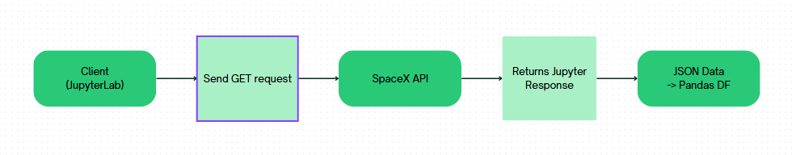
Data Collection - SpaceX API
Key Concepts:
REST API (Representational State Transfer): Allows client applications to fetch data from a server using HTTP methods
GET Request: Used to retrieve JSON data from the SpaceX API endpoints.
Workflow:
GitHub URL: Data Collection

Slide 10
Data Collection - Scraping
Scraped “List of Falcon 9 and Falcon Heavy launches” using BeautifulSoup
Extracted table rows for each launch, including:
Launch date & time
Booster version
Payload mass
Orbit
Launch outcome and landing status
GitHub URL: Web Scraping

Slide 11
Data Wrangling
Raw SpaceX API JSON
Wikipedia Scraped Table
CSV files
Initial Pandas DF
Merged into Single DataFrame
Clean & Standardize Columns
GitHub URL: Data Wrangling
Handle Missing / Invalid Entries
Final Cleaned Dataset for EDA + ML

Slide 12
Exploratory Data Analysis (EDA) with Data Visualization
Charts Used:
Flight Number vs. Launch Site (Seaborn Catplot)
Why: To observe the distribution of launch attempts across sites and their success classes
Insight: Identified that certain sites had more consistent successes over time
Yearly Success Trend (Seaborn Lineplot)
Why: To track how mission success rates evolved over the years
Insight: Showed a clear improvement in launch success rates over time
Payload vs. Success Rate (Plotly Scatter Plot)
Why: To identify any correlation between payload mass and mission outcome
Insight: Payload mass had some influence on mission success, but not linear
Mission Outcome Distribution (Matplotlib Bar Chart)
Why: To understand the proportion of successes vs failures
Insight: Majority of missions were successful with a few specific failure modes
Booster Versions by Outcome (Seaborn Countplot)
Why: To see which boosters had better success rates
Insight: Some booster versions consistently led to successful landings
GitHub URL: EDA with Visualization

Slide 13
EDA with SQL
Performed SQL Queries:
Displaying the names of the unique launch sites in the space mission
Displaying 5 records where launch sites begin with the string ‘CCA’
Displaying the total payload mass carried by boosters launched by NASA (CRS)
Displaying average payload mass carried by booster version F9 v1.1
Listing the date when the first successful landing outcome in ground pad was achieved
Listing the names of the boosters which have success in drone ship and have payload mass greater than 4000 but less than 6000
Listing the total number of successful and failure mission outcomes
Listing the names of the booster versions which have carried the maximum payload mass
Listing the failed landing outcomes in drone ship, their booster versions and launch site names for the months in year 2015
Ranking the count of landing outcomes (such as Failure (drone ship) or Success (ground pad)) between the date 2010-06-04 and 2017-03-20 in descending order
GitHub URL: EDA with SQL

Slide 14
Build an Interactive Map with Folium
Interactive Map with Folium:
Created Circle Markers
Marked the location of NASA Johnson Space Center using a folium
Circle and a labeled Marker. Added circles at each SpaceX launch site using coordinates from the dataset
Added Launch Site Markers
Used a loop to place folium. Marker objects for each unique launch site with custom labels to help visually identify each site on the map
Labels were rendered using DivIcon for better readability on the map
Added Success and Failure Markers for Each Launch
Introduced color-coded markers using folium. Icon based on launch success (green) or failure (red)
Grouped all these markers using MarkerCluster for better visual organization and map interaction
Why These Objects Were Added:
Circles and Markers: Help users understand the geographic distribution of SpaceX launch sites and identify key facility locations.
Color-coded Icons: Provide an immediate visual cue about the outcome of launches: green for success, red for failure.
Marker Clustering: Avoids clutter when multiple launches happen from the same or nearby coordinates, enhancing map clarity.
GitHub URL: Interactive Map with Folium

Slide 15
Interactive Dashboard with Plotly Dash
Dropdown Menu (Launch Site Selector):
Enables users to choose all sites or a specific launch site.
Interactivity helps dynamically update visualizations based on user input.
Pie Chart (Launch Success Distribution):
Displays overall success rate by site when “All Sites” is selected.
For a specific site, it shows success vs failure distribution.
Helps visualize performance consistency across locations.
Payload Range Slider:
Allows users to adjust the payload mass range (kg) interactively.
This input refines the scatter plot to show filtered results, aiding deeper insight.
Scatter Plot (Payload vs Success):
Plots payload mass on the x-axis and launch outcome (class) on the y-axis.
Uses color-coded points to represent different booster version categories.
Helps identify any correlation between payload mass, booster type, and success rate.
Why These Plots and Interactions Were Added:
To enable real-time exploration of launch data without modifying code.
To help users filter and focus on specific launch sites, payload ranges, and mission outcomes.
To support data-driven storytelling through visual interactivity and drill-down exploration.
GitHub URL: Dashboard with Plotly Dash

Slide 16
Predictive Analysis (Classification)
Data Preprocessing:
Merged datasets and standardized features using StandardScaler.
Split data into training and testing sets.
Models Evaluated:
Logistic Regression, SVM, Decision Tree, K-Nearest Neighbors (KNN).
Hyperparameter Tuning:
Used GridSearchCV (cv=10) to find best parameters for each model.
Evaluation Metrics:
Jaccard Score, F1 Score, Accuracy, and Confusion Matrix.
Best Model – Decision Tree:
Accuracy: 91.1%
F1 Score: 0.937
Jaccard Score: 0.882

Slide 17
Predictive Analysis (Classification)
Data Collection
Preprocessing
Train-Test Split
Model Selection
Best Model
Evaluation
GridSearchCV
GitHub URL: Predictive Analysis

Slide 18
Results
SQL: Identified launch patterns, booster names, and success rates.
EDA: Visualized trends across years, sites, and payloads.
Folium Map: Mapped launch sites with success/failure markers.
Dash App: Interactive pie and scatter plots for insights.
ML Models: Decision Tree gave highest accuracy and F1 score.

Slide 19
Insights drawn from EDA
#2

Slide 20
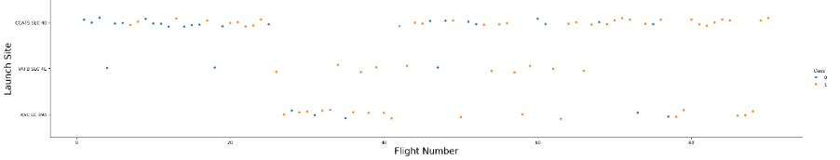
Flight Number vs. Launch Site
Inferences:(orange = success, blue = failure)
Launch success rates generally improve with higher flight numbers, indicating learning over time.
Some sites (e.g., KSC LC-39A) show a higher density of successful launches, suggesting better performance.
Other sites like VAFB SLC-4E have fewer data points, which might reflect fewer launches or lower reliability.

Slide 21
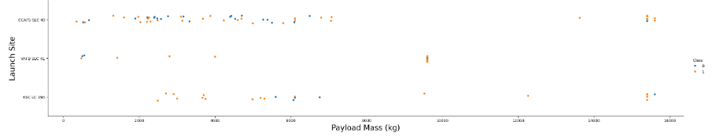
Payload vs. Launch Site
Inferences:(orange = success, blue = failure)
Most payloads between 2000-8000 kg have a higher success rate (orange).
Sites like CCAFS SLC-40 handled a wider range of payloads and had more frequent launches, showing operational capacity.
Heavier payloads (above 8000 kg) still achieved success, indicating reliable booster performance at high loads.
Launch sites with fewer missions (e.g., VAFB SLC-4E) had less data to establish trends.

Slide 22
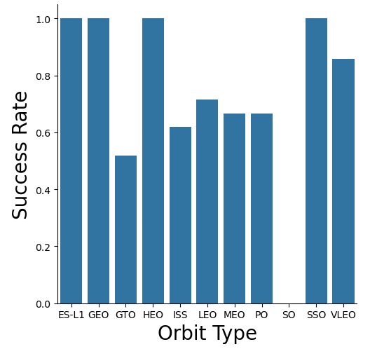
Success Rate vs. Orbit Type
Inferences:
ES-L1, GEO, HEO, and SSO orbits have a 100% success rate, showing consistent mission performance.
GTO (Geostationary Transfer Orbit) has the lowest success rate, indicating higher mission complexity or risk.
LEO, MEO, and PO have moderate success rates (~6-–70%), suggesting room for improvement or greater variability in missions.
VLEO (Very Low Earth Orbit) also shows strong reliability with an 85% success rate.

Slide 23
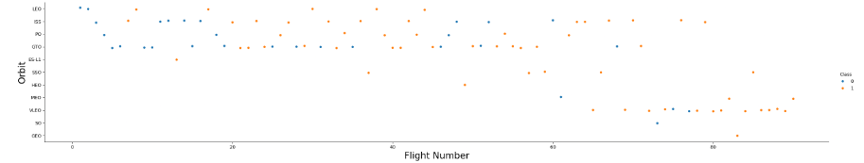
Flight Number vs. Orbit Type
Inferences:(orange = success, blue = failure)
As flight numbers increase, the number of successful missions (orange dots) increases, indicating improved reliability over time.
Early flights had a higher concentration of failures, especially in LEO and GTO orbits.
Later missions targeting SSO, GEO, and HEO show high consistency in success.
LEO remains the most frequently targeted orbit, though success is mixed early on.

Slide 24
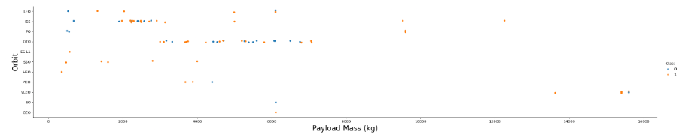
Payload vs. Orbit Type
Inferences:(orange = success, blue = failure)
Success is consistent across a wide range of payloads, particularly in LEO, GTO, and SSO orbits.
Heavier payloads above 8000 kg are still seeing high success rates, indicating good performance under high load.
Failures are scattered across all payload ranges, but there is no strong correlation between higher mass and increased failure.
LEO and GTO remain popular for varied payload sizes, with decent reliability.

Slide 25
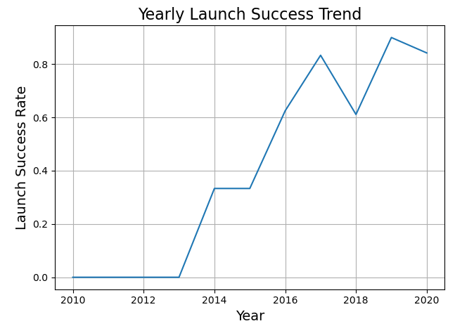
Launch Success Yearly Trend
Inferences:
From 2010 to 2013, success rate remained at 0, indicating failed or no launches.
A noticeable improvement began in 2014, reaching a peak of ~90% in 2019.
Although there was a dip in 2018, overall trend shows strong improvement in launch reliability over time.
This highlights SpaceX’s growing efficiency and technical advancements in rocket launches.

Slide 26
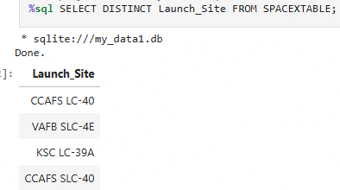
All Launch Site Names
Explanation:
Display the names of the unique launch sites in the space mission

Slide 27
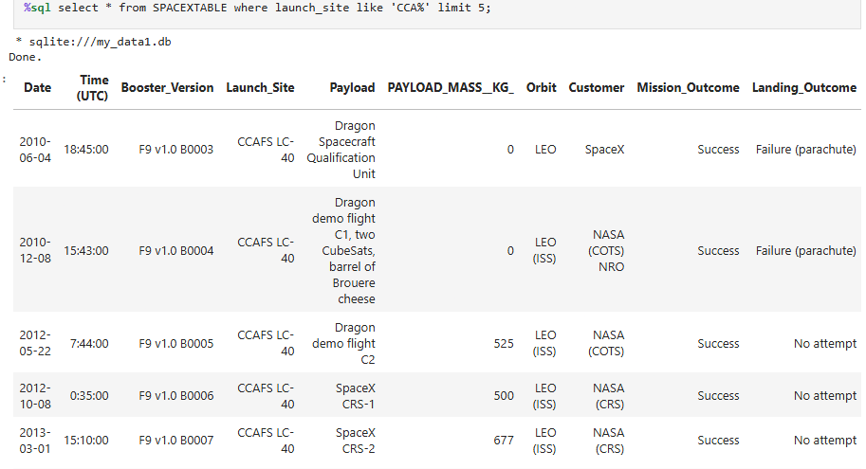
Launch Site Names Begin with 'CCA'
Explanation:
Display 5 records where launch sites begin with the string 'CCA'

Slide 28
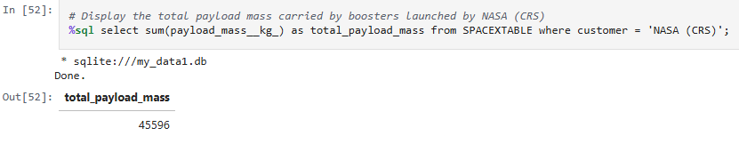
Total Payload Mass
Explanation:
Display the total payload mass carried by boosters launched by NASA (CRS)

Slide 29
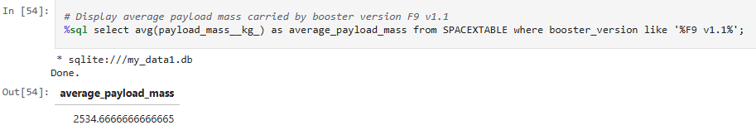
Average Payload Mass by F9 v1.1
Explanation:
Display average payload mass carried by booster version F9 v1.1

Slide 30
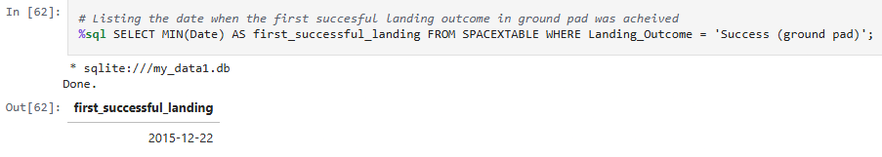
First Successful Ground Landing Date
Explanation:
Listing the date when the first succesful landing outcome in ground pad was acheived

Slide 31
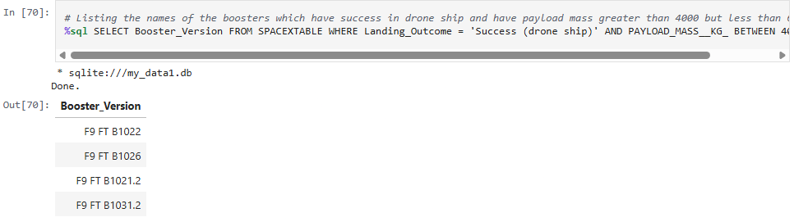
Successful Drone Ship Landing with Payload between 4000 and 6000
Explanation:
Listing the names of the boosters which have success in drone ship and have payload mass greater than 4000 but less than 6000

Slide 32
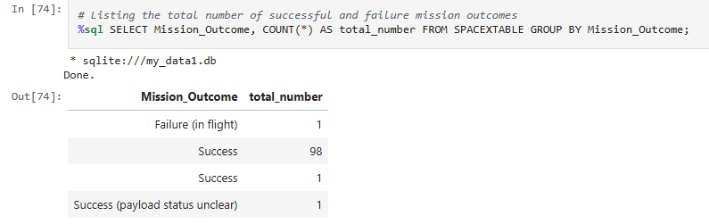
Total Number of Successful and Failure Mission Outcomes
Explanation:
Listing the total number of successful and failure mission outcomes

Slide 33
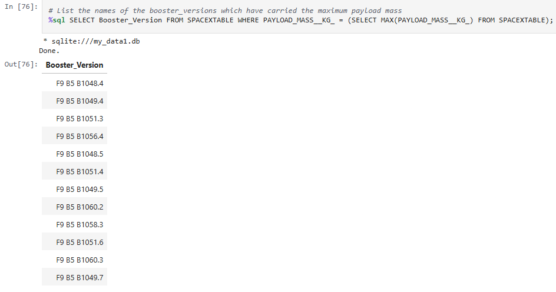
Boosters Carried Maximum Payload
Explanation:
List the names of the booster_versions which have carried the maximum payload mass

Slide 34
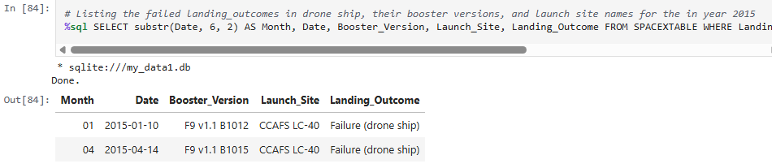
2015 Launch Records
Explanation:
Listing the failed landing_outcomes in drone ship, their booster versions, and launch site names for the in year 2015

Slide 35
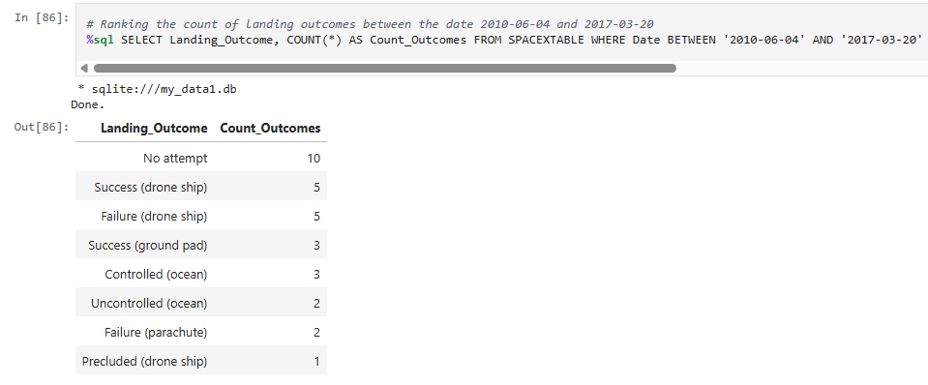
Rank Landing Outcomes Between 2010-06-04 and 2017-03-20
Explanation:
Ranking the count of landing outcomes between the date 2010-06-04 and 2017-03-20

Slide 36
Launch Sites Proximities Analysis
#3

Slide 37
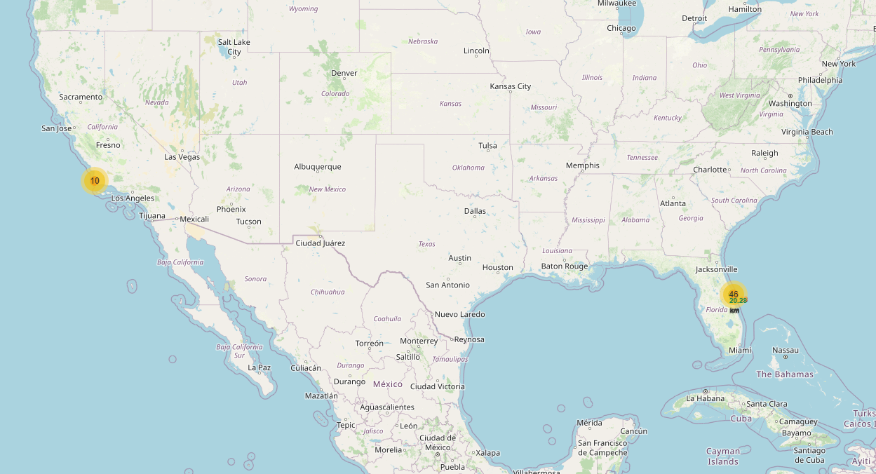
SpaceX Launch Site Distribution - Interactive Folium Map
Explanation:
Most of the launch sites shown on the map are located near the equator as:
Launching near the equator provides a boost from Earth's rotation, allowing rockets to achieve orbital velocity more efficiently, saving fuel and cost.
Vandenberg AFB in California, while farther from the equator, is used for polar orbits, which require different trajectories.
This strategic distribution of launch sites supports mission flexibility while optimizing energy efficiency and payload capacity.
The launch sites are also close to the coast to minimize harm to people by debris from the rocket

Slide 38
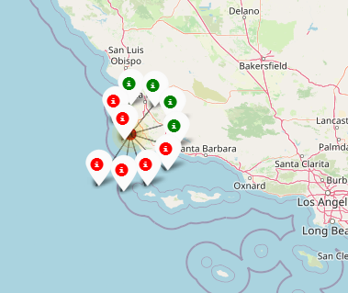
Colour Labelled Markers to Indicate Outcomes of Launch Sites
Explanation:
The colour labelled markers help in identifying successful and unsuccessful launches.
Green indicates successful launch
Red indicates unsuccessful launch
The Vandenberg launch site has more unsuccessful launches than successful launches

Slide 39
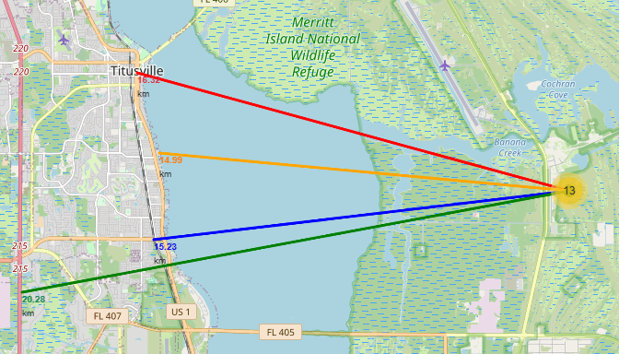
Kennedy Space Center - Proximity to Key Infrastructure
Explanation:
This map shows the Kennedy Space Center launch site and its measured distances to surrounding infrastructure:
Highway (US 1) ~20.28 km
Railway line ~15.23 km
Coastline ~14.99 km
Nearby city (Titusville) –~16.13 km
The close proximity to transportation networks (highway and railway) enhances logistical efficiency for equipment and personnel movement.
Being near the coastline enables safe rocket trajectory over open ocean, reducing risk to human life and property in case of failure.
The location near the city ensures accessibility while maintaining a buffer for safety and environmental compliance.

Slide 40
Interactive Dashboard with Plotly Dash
#4

Slide 41
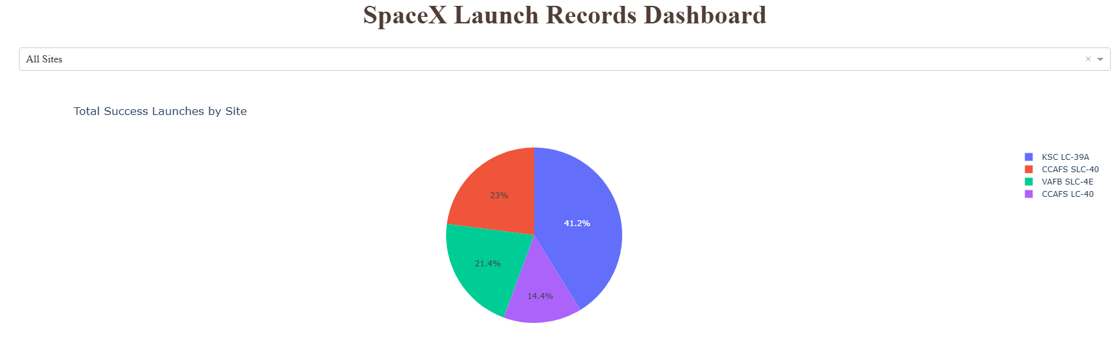
Launch Site Success Distribution
Explanation:
The chart indicates that KSC LC-39A has the most successful launches

Slide 42
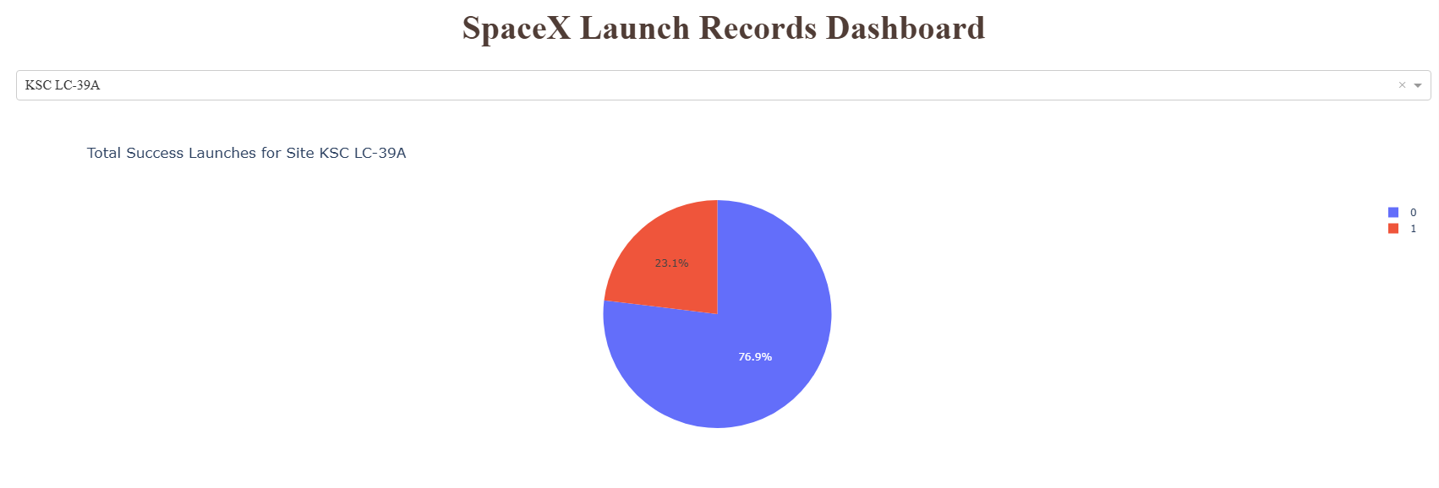
Launch Success Distribution - KSC LC-39A Site
Explanation:
This pie chart from the Plotly Dash dashboard displays the success rate of launches from the KSC LC-39A launch site which has the highest launch success ratio
76.9% of launches were successful
23.1% failed

Slide 43
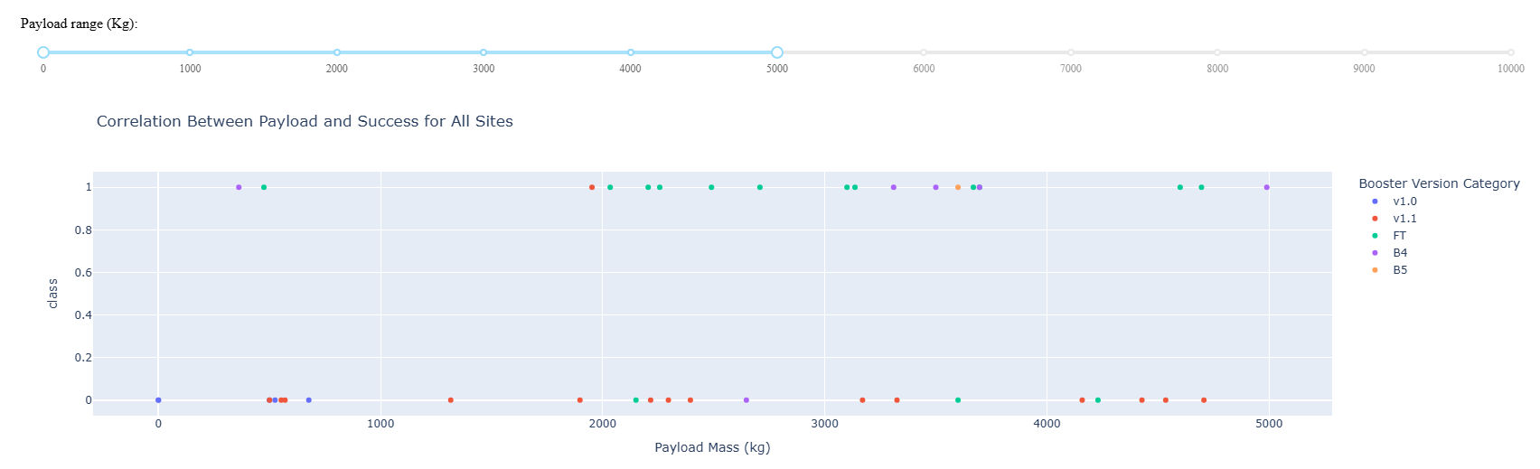
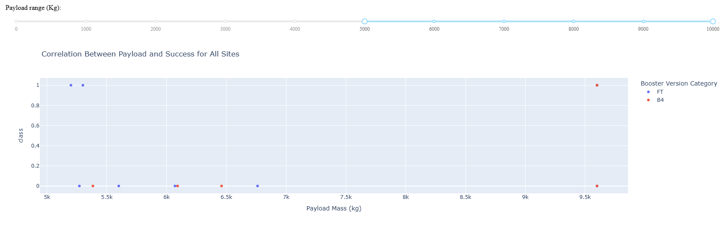
Correlation Between Payload Mass, Booster Version and Launch Outcome
Explanation:
Booster FT has the best overall performance across both payload ranges.
Lower and mid-range payloads (up to 5000 kg) show more frequent and successful launches.
Higher payloads (above 5000 kg) have fewer launches and a higher failure rate, especially with older boosters like B4.
This supports that payload mass and booster version significantly affect success rates, and FT is most reliable.

Slide 44
Predictive Analysis (Classification)
#5

Slide 45
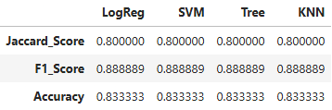
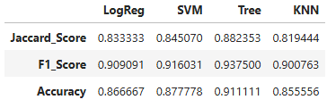
Classification Accuracy
Scores from Test Set
Scores from Whole Dataset
Explanation:
As observed from the scores of the test set, we cannot determine which model has the best accuracy.
But from the scores of the whole dataset, we can determine that the Decision Tree Model has the highest accuracy and also the highest scores.
Thus, the Decision Tree is the best model for this scenario.

Slide 46
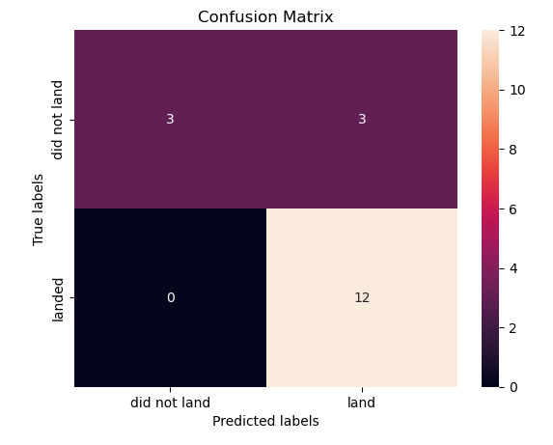
Confusion Matrix For Decision Tree Classifier
Explanation:
True Positives (12): The model correctly predicted 12 launches that successfully landed
True Negatives (3): It correctly predicted 3 launches that did not land
False Positives (3): It incorrectly predicted 3 failed landings as successes
False Negatives (0): It did not miss any successful landings
Insights:
The model shows a strong bias toward catching successful landings with zero false negatives.
A few failed landings were misclassified as successful (false positives), suggesting some overlap in features for those specific cases.
Overall, this confusion matrix confirms the high performance and reliability of the Decision Tree model for predicting SpaceX launch outcomes.

Slide 47
Conclusion
Using EDA and Visualization we found that:
Launches with lower payload masses had higher success rates than those with larger payloads
KSC LC-39A had the highest success rate among all launch sites
Orbits like GEO, ES-L1, HEO, and SSO achieved 100% success rates
The success rate of launches increased year over year, showing operational improvement.
Using Folium Interactive Maps we discovered that:
Launch sites were strategically located close to the Equator and coastlines, ideal for maximizing efficiency and booster recovery
This also helps in minimizing risk to people via rocket debris
Through predictive modelling:
We built and tuned multiple classifiers (LogReg, SVM, Tree, KNN)
We analyzed that the Decision Tree Classifier performed the best with 91.1% accuracy and highest F1-score

Slide 48
Appendix
Project Link: GitHub URL

Slide 49
Thank You

